Slide 1
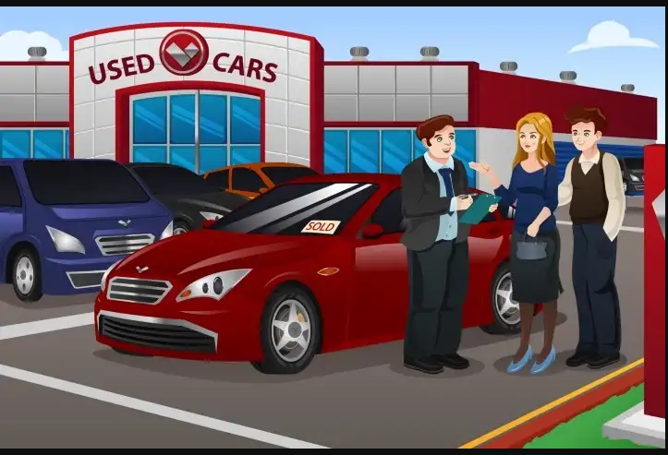
EDAeda
EDA
On
USED CARS
JYOTI VYAS

Slide 2
Content
1.Introduction
2.Problem statement
3.Data pre-profiling
4.Data Post-profiling
5.Visual analysis
6.Conclusion
7.Actionable Insights

Slide 3
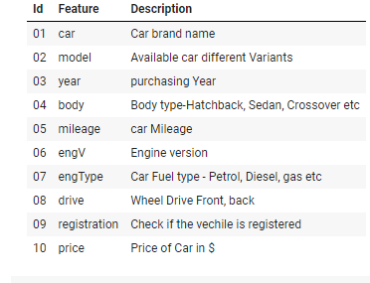
Introduction
Dataset contains one of the used cars company sales.
Dataset is approximately 10k
Few decades sales history

Slide 4

Problem Statement
In the past few years, prices of new cars have skyrocketed, due to which most people are incapable of buying a new one.
The company has earned its name because of sincerity in work and quality of services.
But for past few months their sales is down

Slide 5
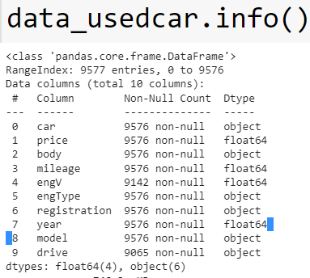
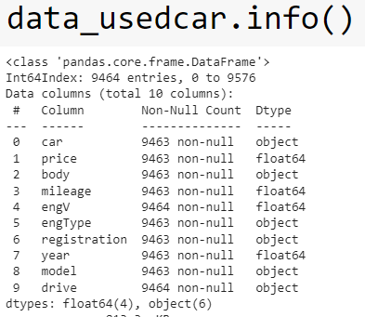
Data pre and Post profiling
Report using data.info before data pre processing
engV and drive have missing values
Price and mileage have zeros values
After processsing
Drive missing values have been replaced by mode.
Price ,mileage ,engv values have been filled by median .

Slide 6
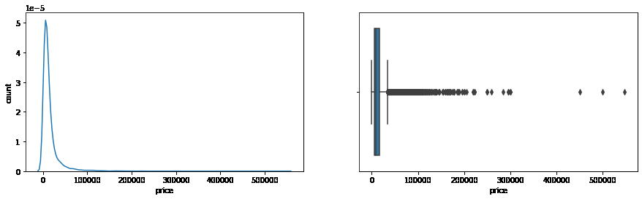
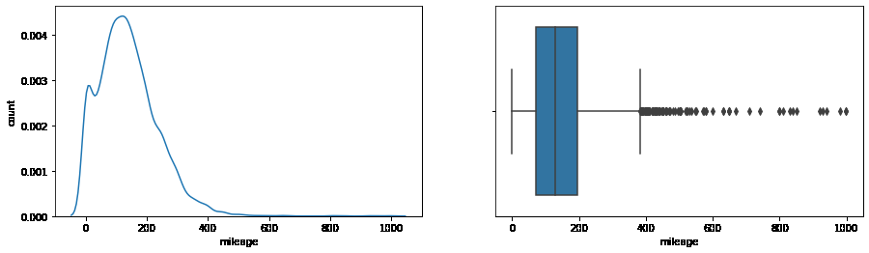

Slide 7
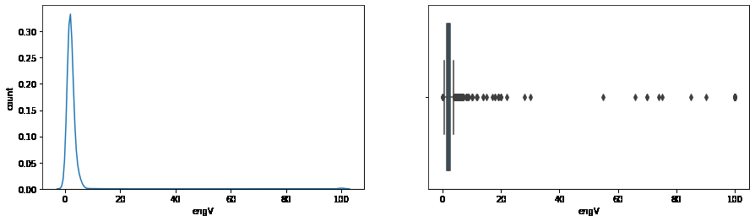
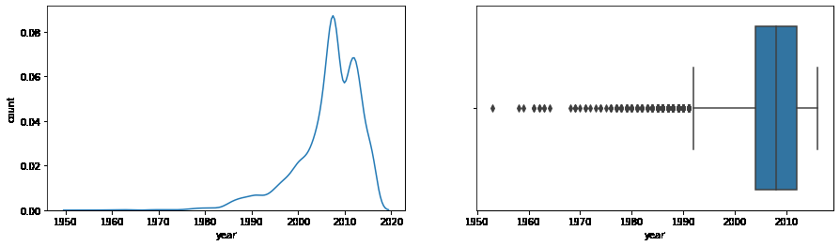

Slide 8
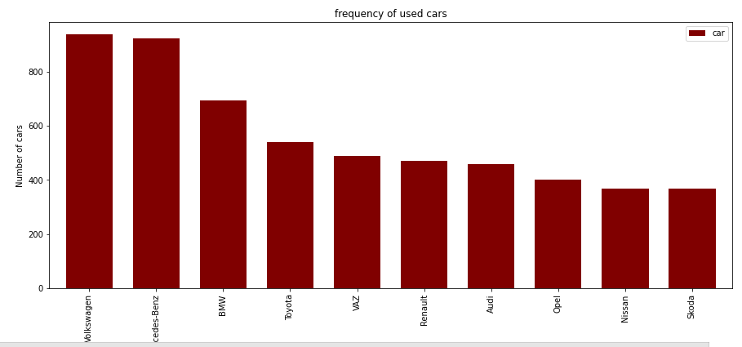
Data Visualization

Slide 9
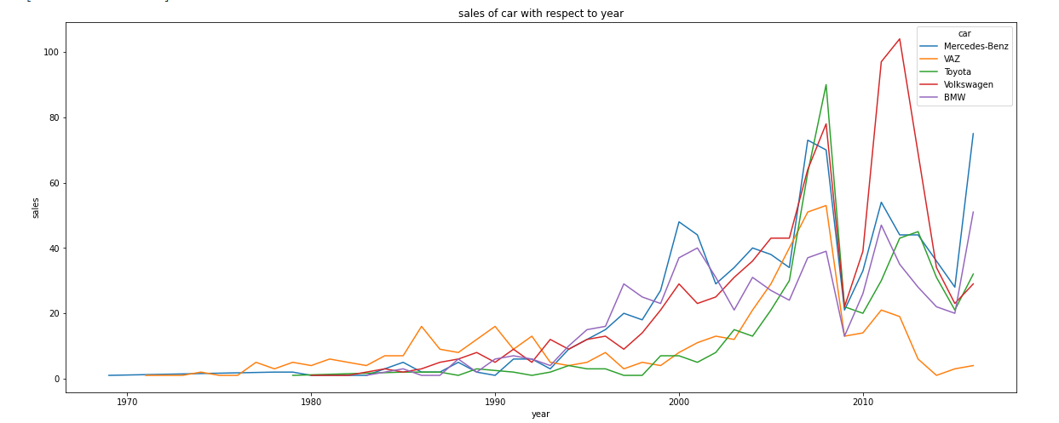

Slide 10
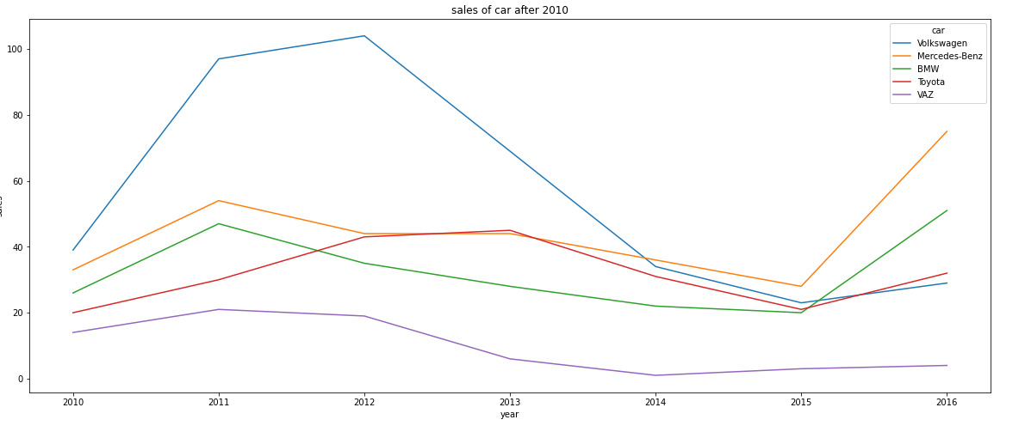

Slide 11
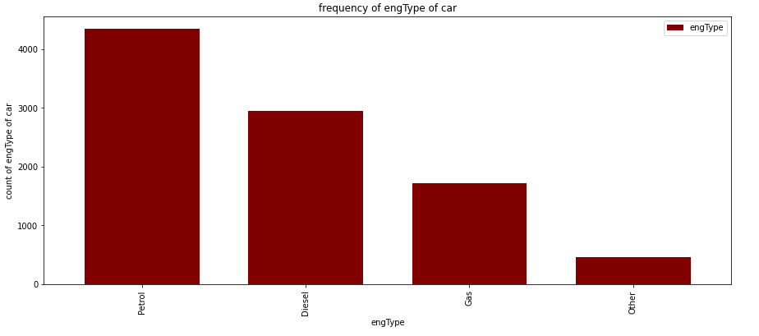
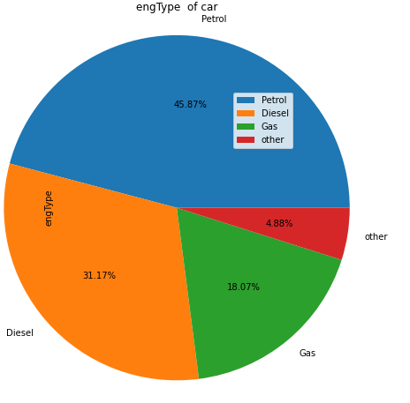

Slide 12
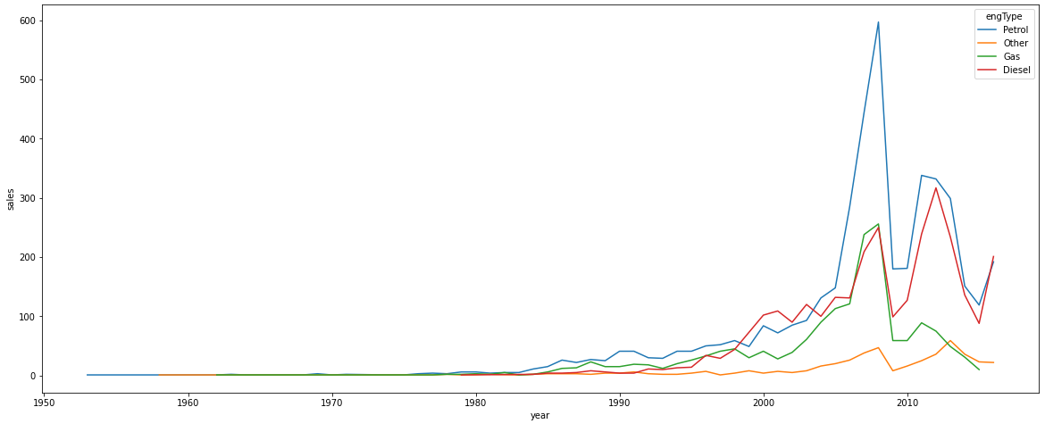

Slide 13
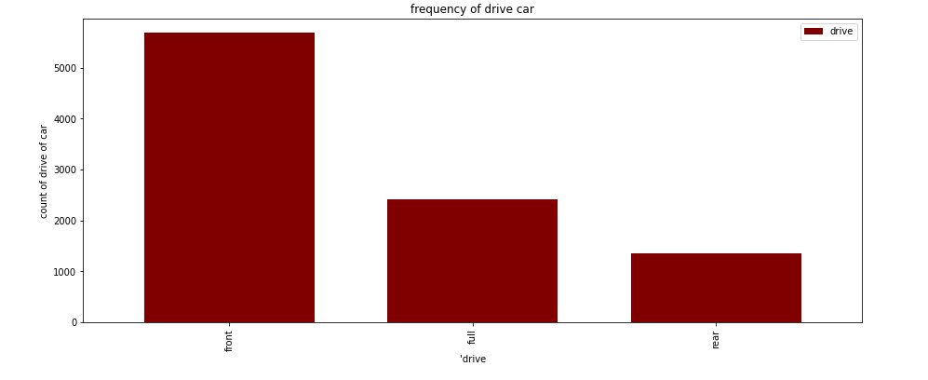
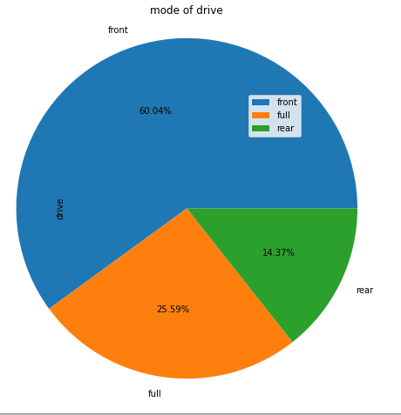

Slide 14
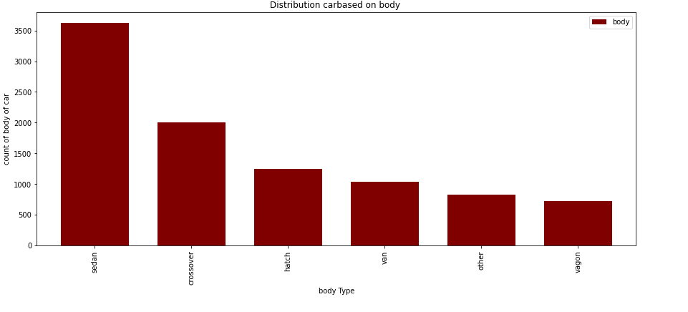

Slide 15
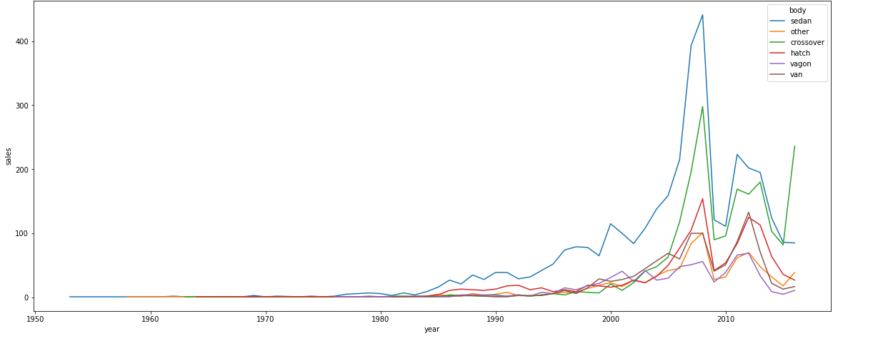

Slide 16
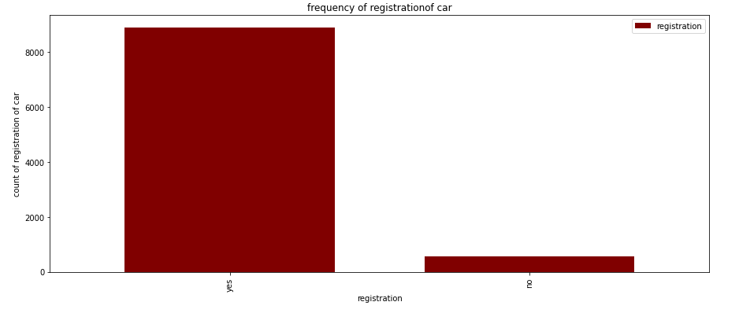
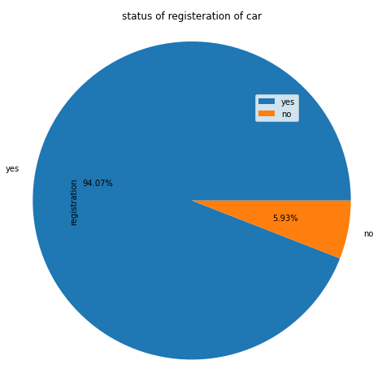

Slide 17
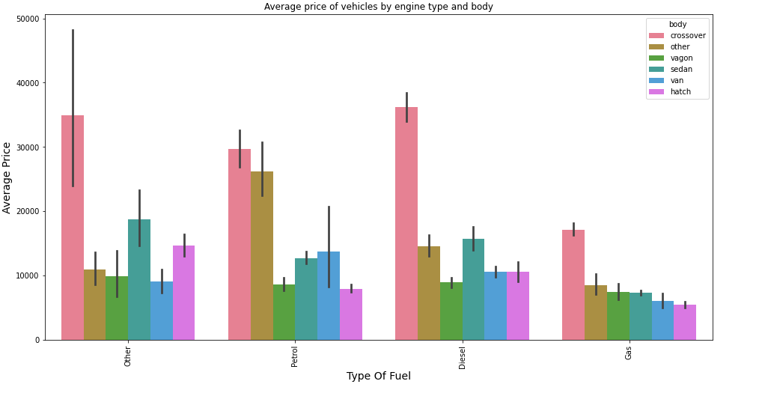

Slide 18
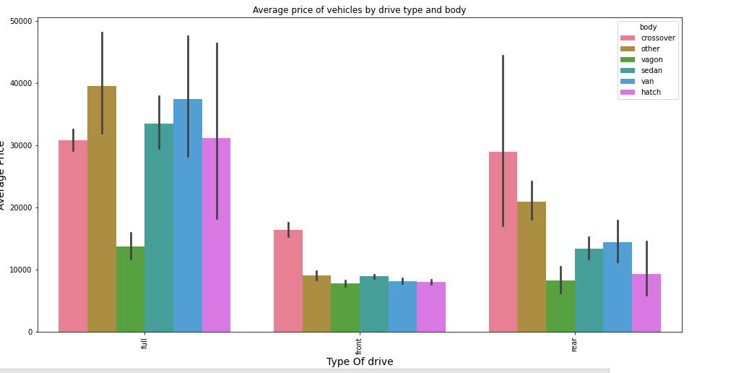

Slide 19
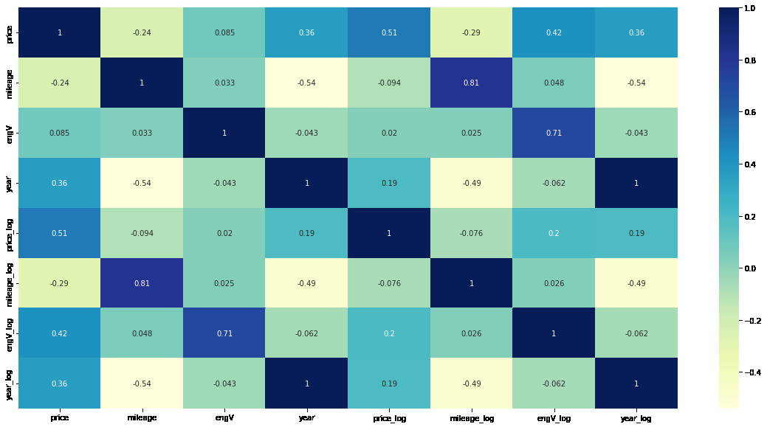
Multivariate analysis

Slide 20
CONCLUSION
1.Volkswagen and Mercedes-Benz are the most popular brands.
2. Petrol engine type is most preferred, while diesel is preferred
comparatively little lesser.
3. Sedan is the most popular body type. There are significant number of
other body type cars available too.
4. Cars of the model year, from around last 15 years (2000- 2016) are
high for sale.
5.Unregistered cars, though cheaper in price, are not preferred.

Slide 21
ACTIONABLE INSIGHT
1.Cars should be available from all price ranges.
As 10000 to 40000 / is the most sales happening price range and there
are no cars available in 20000 to 36000 / price bracket procuring these
price ranged cars should potentially improves the sales.
2.Sense the customer likelihood and market more such cars.
3. Petrol and Diesel cars are most popular
4.Less preferred old cars should be announced with great deals and clear the stock. In that way we can save money, renting space for storage

Slide 22


